Slide 1
Week 2
Wang Lab PE Brush Subgroup
02/13/2025

Slide 2
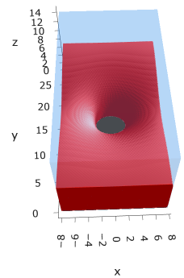
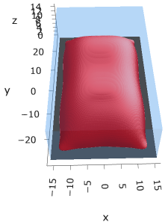
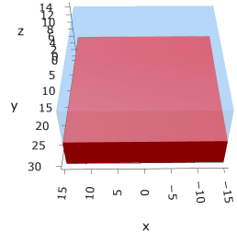
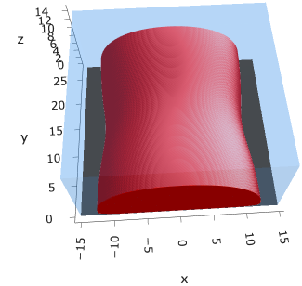
Overview
So far, I’ve observed four morphologies at alpha = 0.0 (uncharged) and sigma = 0.005 (sparsely grafted).
This week, I’d like you to try the micelle (second from left) and the stripe (rightmost). I’ll try the hole (leftmost).

Slide 3
Tasks
On the next slides, I’m giving you each a morphology and three box sizes. Try your best to get each box size closer to convergence (and_err ~ 1e-05).
To upload files to the cluster, go to ondemand.anvil.rcac.purdue.edu; the process is the same as downloading: Files/Project/{folder you want}/. Button for Upload
Each boxsize should take up a different subfolder.
I’m providing an initial seed (_W_0in.dat) for each morphology.
After your first run, feel free to use whatever you want as the seed for subsequent runs, just make sure to change win_nx, win_ny, and win_nz accordingly.
Try 3-5 runs for each boxsize. For each run, record what optimization parameters you used in s*t and what the output to printout.dat was. You can do this by just writing it down on paper or copying them to differently named files.
Don’t forget to check that your morphology didn’t change after each run before using it as the input for the next run.

Slide 4
Terran - micelle
The original file is _W_mic_0213.dat. The ph file is similarly named.
The seed box size is (lx, ly, lz) = (16, 27.6, 15), (nx, ny, nz) = (80, 138, 75).
I would like you to try the following three box sizes:
(16, 27.6, 15)
(20, 27.6, 15)
(20, 32, 15)
The box sizes are very large, so run if for a day (timelimit is set in submit.sh) and see how many iterations it gets to. If it’s below 200, change the timelimit to 36 hours instead of 24 for the next runs.
If the morphologies aren’t plotting (out of memory error on chrome), change nz_coarse = 2 or 3. It’ll look uglier but it’s on my todo list to improve it

Slide 5
Josh - stripe
The original file is _W_str_0213.dat. The ph file is similarly named.
The seed box size is (lx, ly, lz) = (15, 13.8, 15), (nx, ny, nz) = (75, 69, 75).
I would like you to try the following three box sizes:
(15,13.8, 15)
(20, 13.8, 15)
(15, 15, 15) *
* For the last one, please set init_opt = 1 in input.h. I will explain this one next week.

